Slide 1

BookWithMe (Online Rental Booking System)
Developed By:
Prayag Desai
Internal Guide
Prof. Brijesh S. Bhatt
Dept. of Computer Engineering
Prof. Pandav K. Patel
Dept. of Computer Engineering

Slide 2
Contents
Project Overview
Functional Requirements
Activity Diagrams
Technologies Used for Development
Screenshots
Conclusion
Future Enhancement

Slide 3
Project Overview
BookWithMe is an online platform for renting properties.
BookWithMe helps homeowners to rent their spare rooms or entire property for about just days, weeks or months.
BookWithMe will benefit homeowners to generate passive income on their property which they no longer use.
BookWithMe allows Non Registered Users to explore properties which are hosted by the Registered Hosts.
The Registered Users can book properties for pre-specified period of time on location provided where BookWithMe has properties registered by Registered Hosts.
BookWithMe benefits the users as it is cheap compared to booking a motel and the service is excellent.

Slide 4
Functional Requirements
Authentication for Registered Users and Hosts
Registration for becoming Registered Hosts and Registered Users
User can book and explore properties by location check-in-date, check-out-date and accommodation per rental property
Users and Hosts can change their credentials.
Registered users can manage bookings. i.e Delete, Edit and View details about the bookings
Registered Users can view properties booked by them earlier.
Registered Hosts can host their properties on rent for users
Registered Hosts can Edit the property information.

Slide 5
Registered Hosts can make their property inactive for the users to book
Registered Hosts can View bookings made by the users
Registered users can make their inactive property active

Slide 6
Technologies
HTML, CSS, JavaScript, jQuery and Bootstrap is used for front end development.
EJS templating engine
MongoDB for database development.
Nodejs and Express for back-end development
Stripe for implementing payment services.

Slide 7
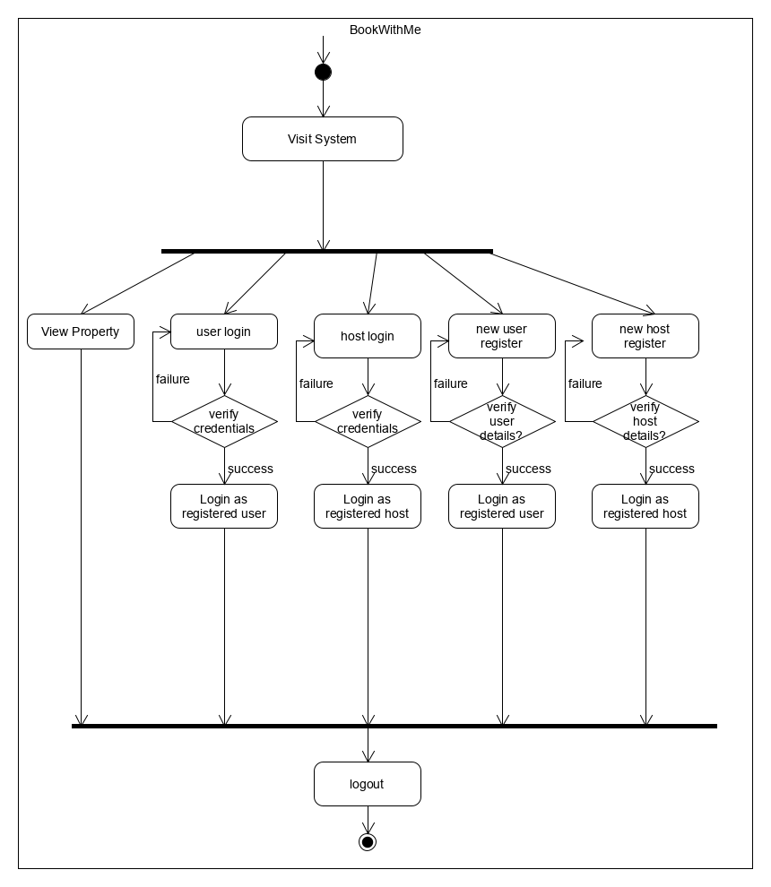
Activity Diagram for non-registered users.

Slide 8
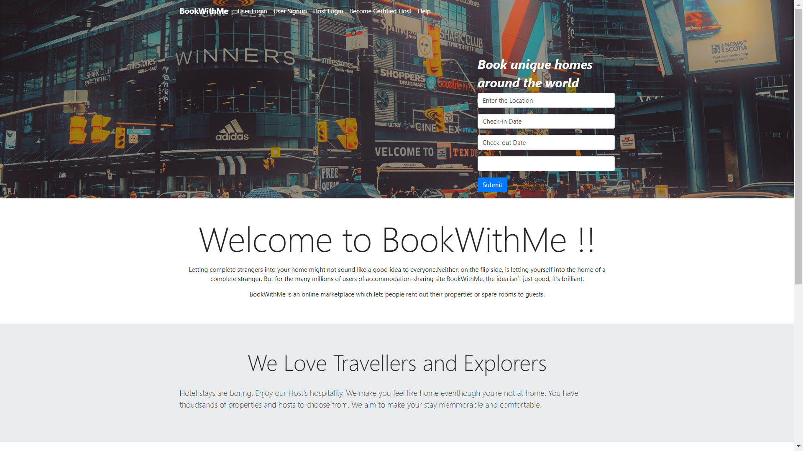
Index Page

Slide 9
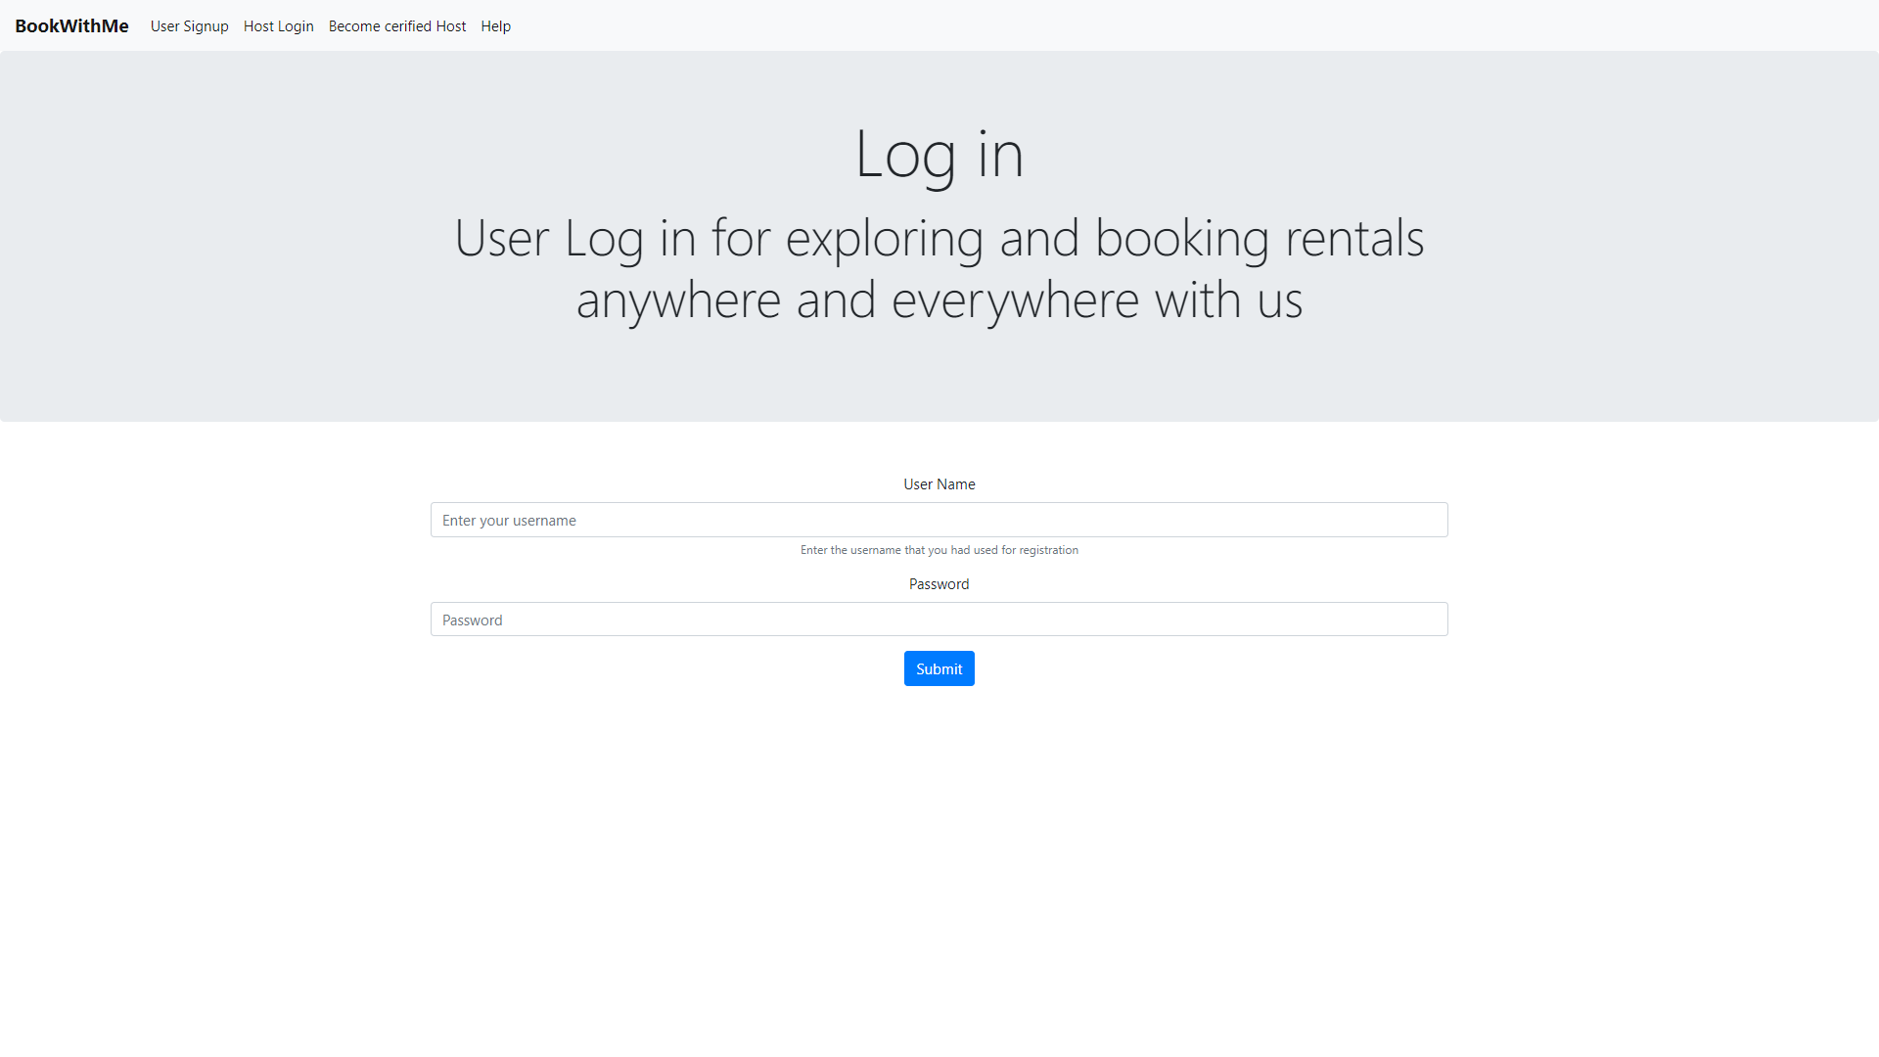
User Log-in

Slide 10
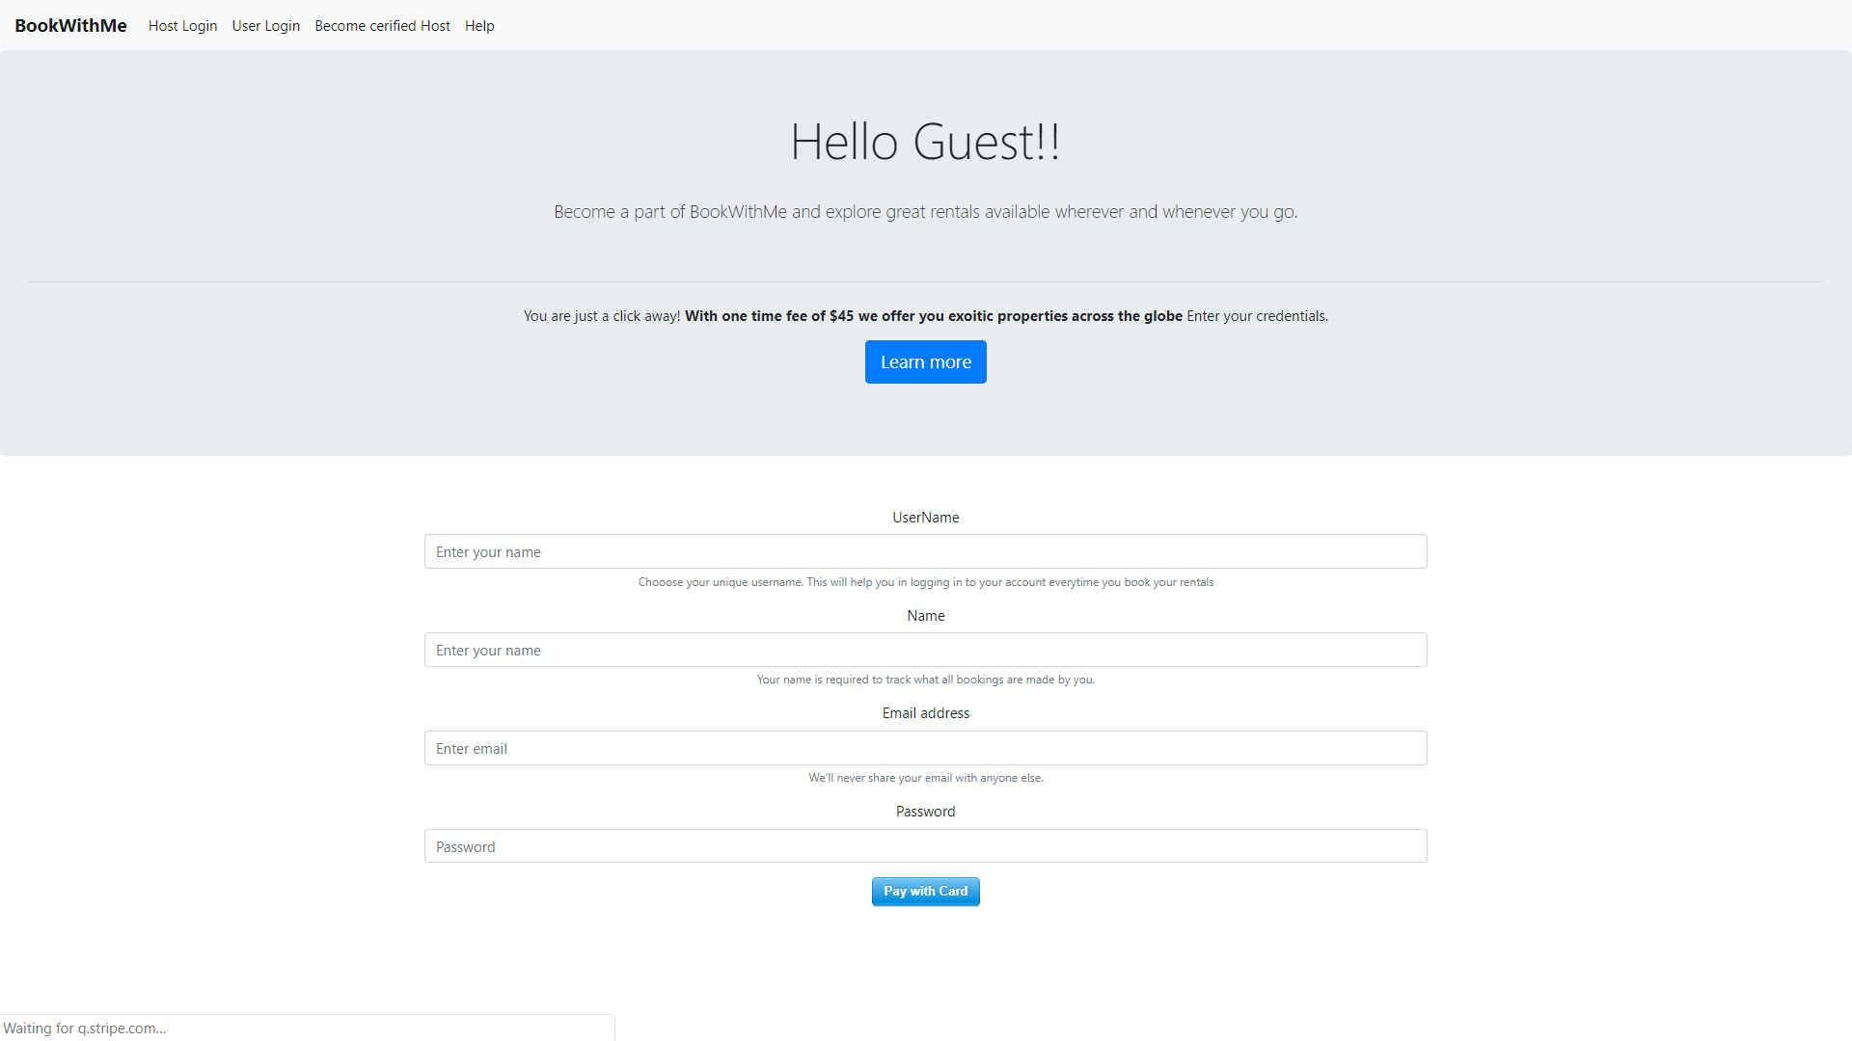
User signup

Slide 11
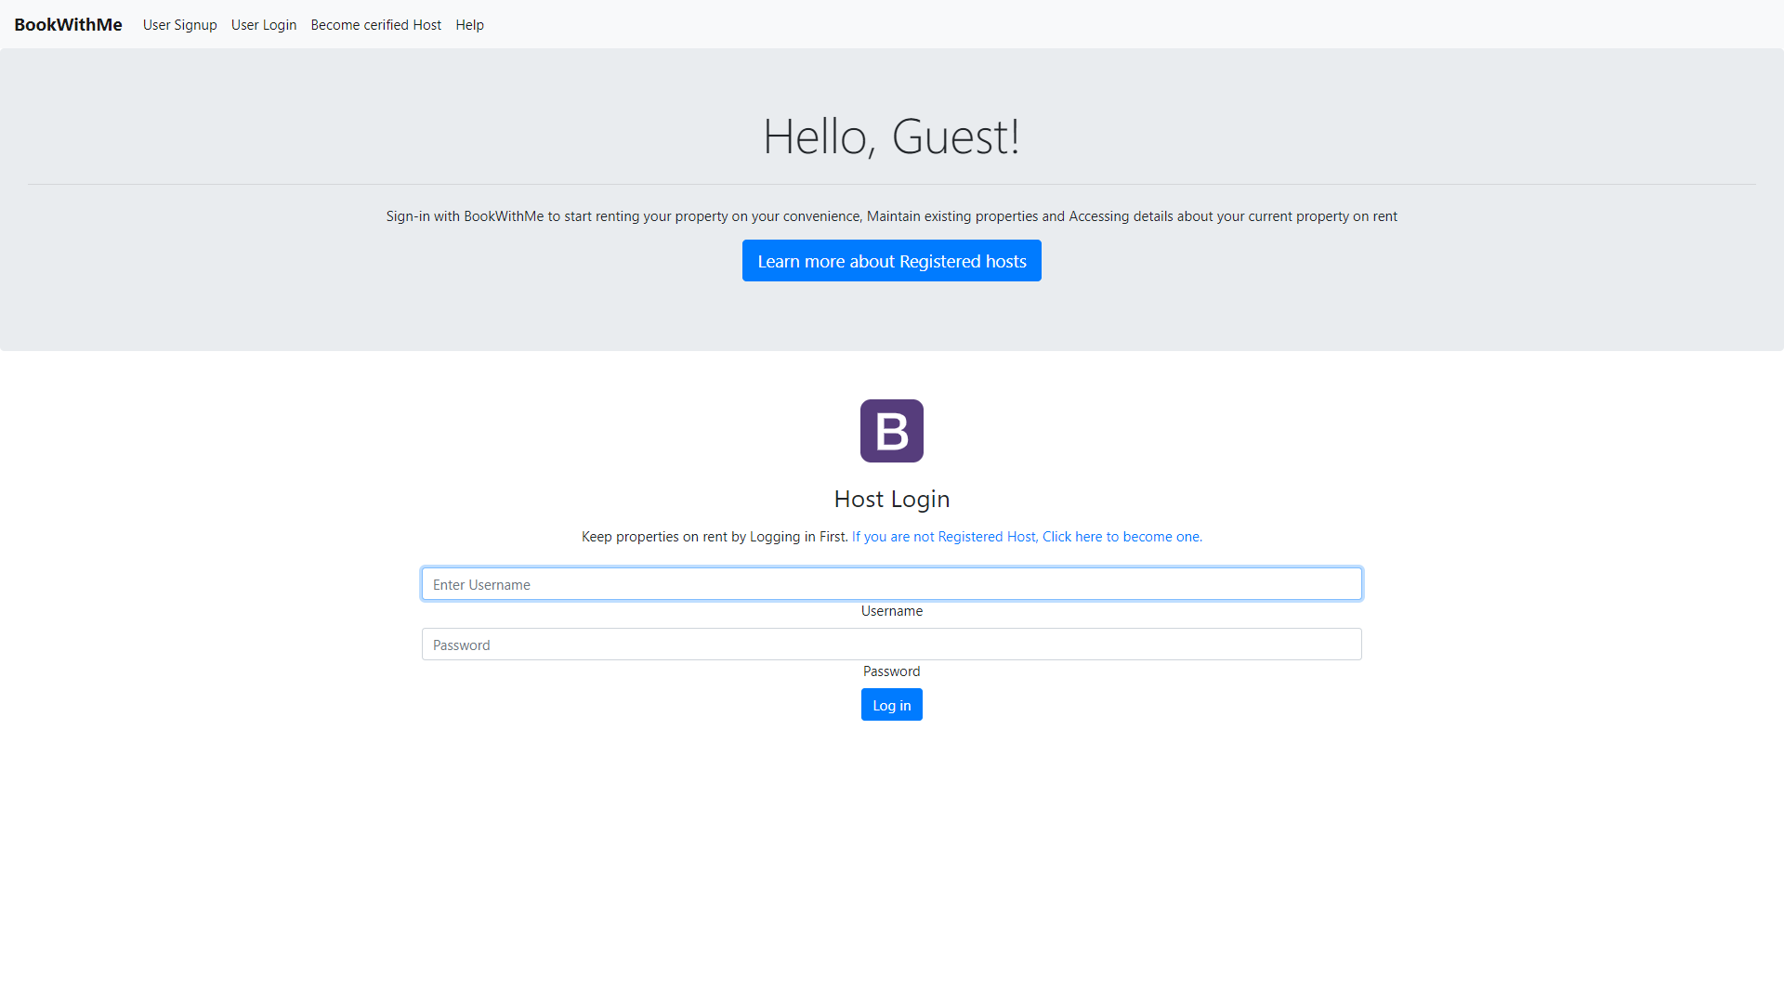
Host log-in

Slide 12
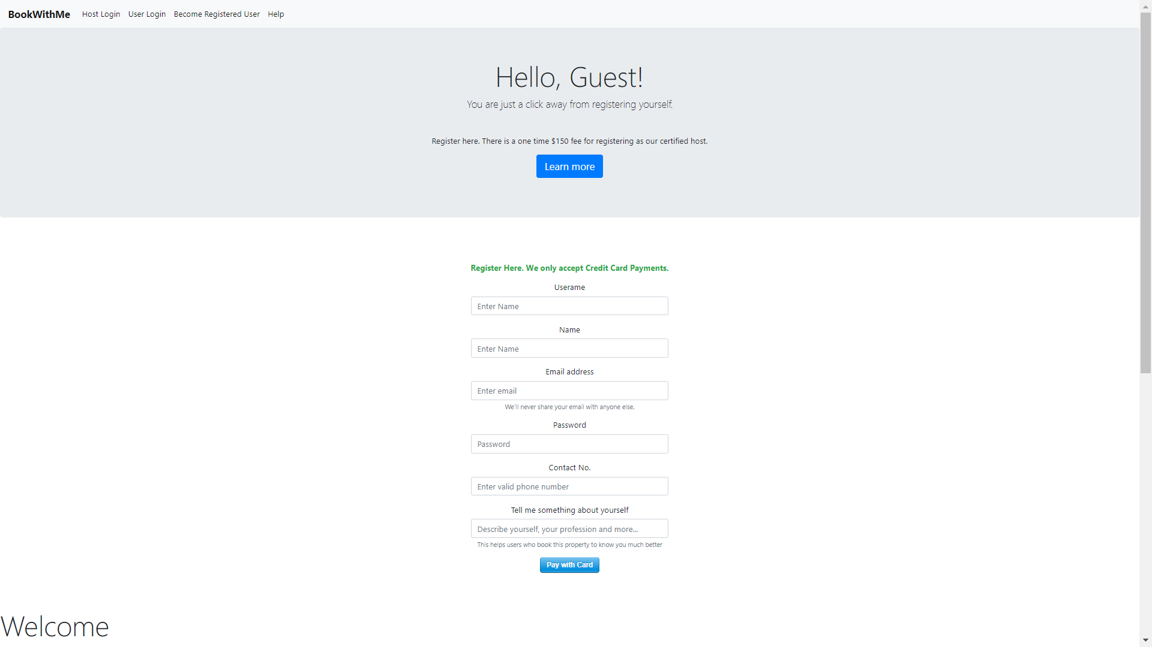
Host Signup

Slide 13
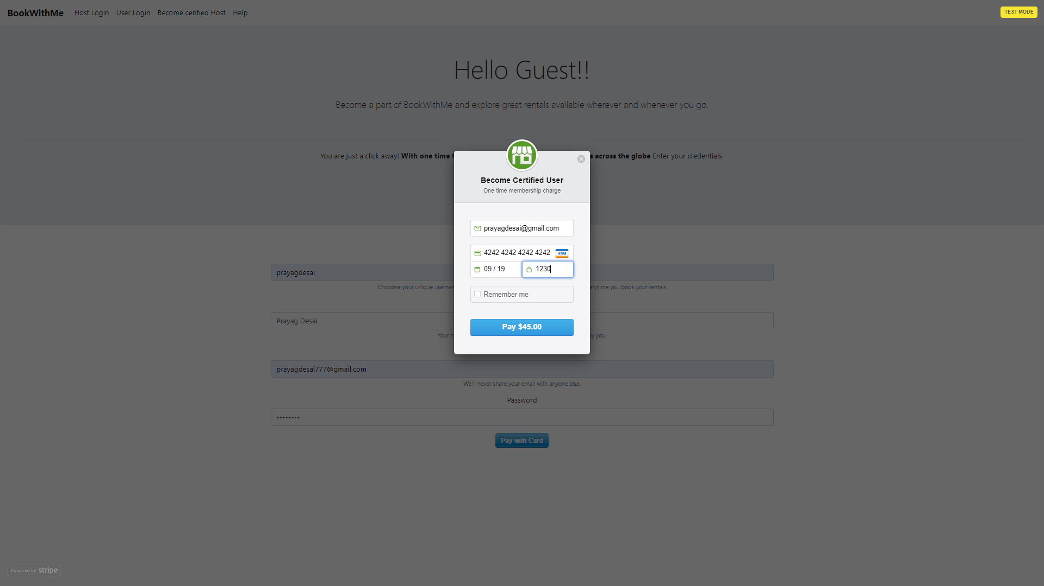
Stripe Payment

Slide 14
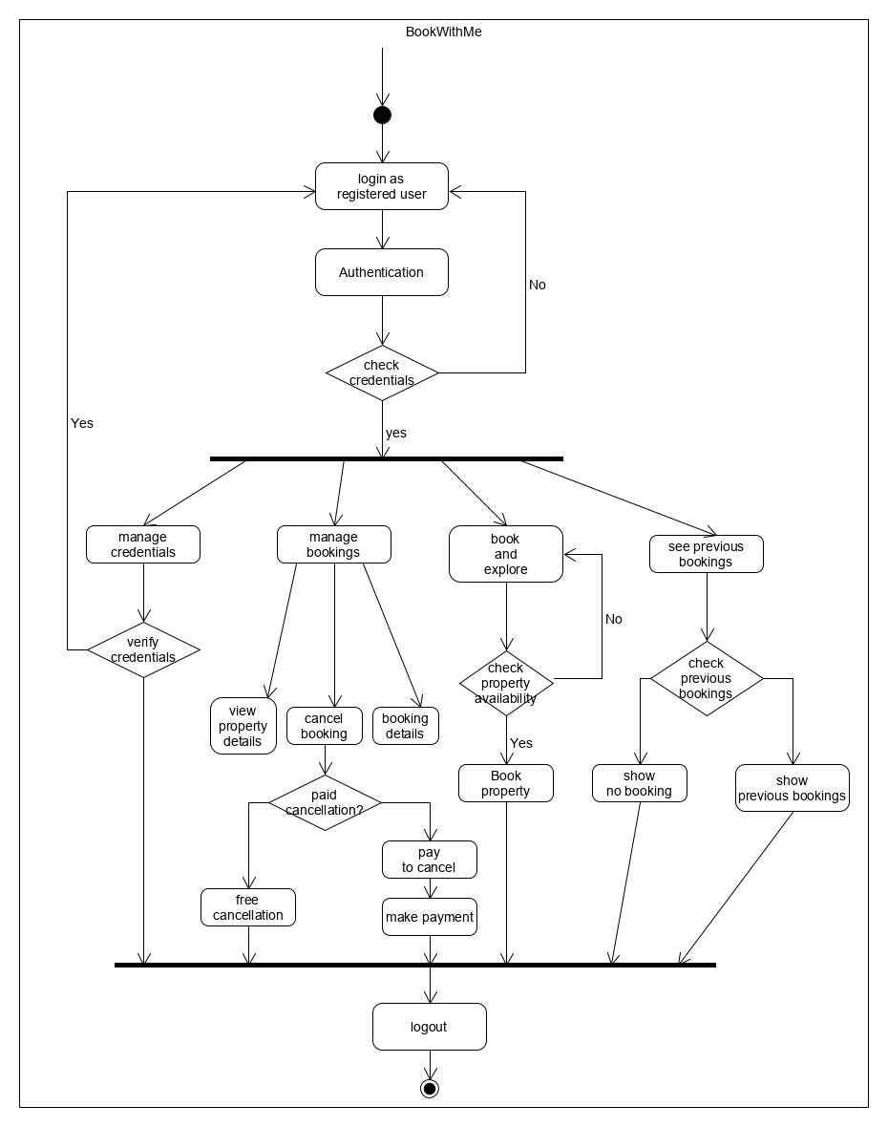
Activity Diagram for registered Users

Slide 15
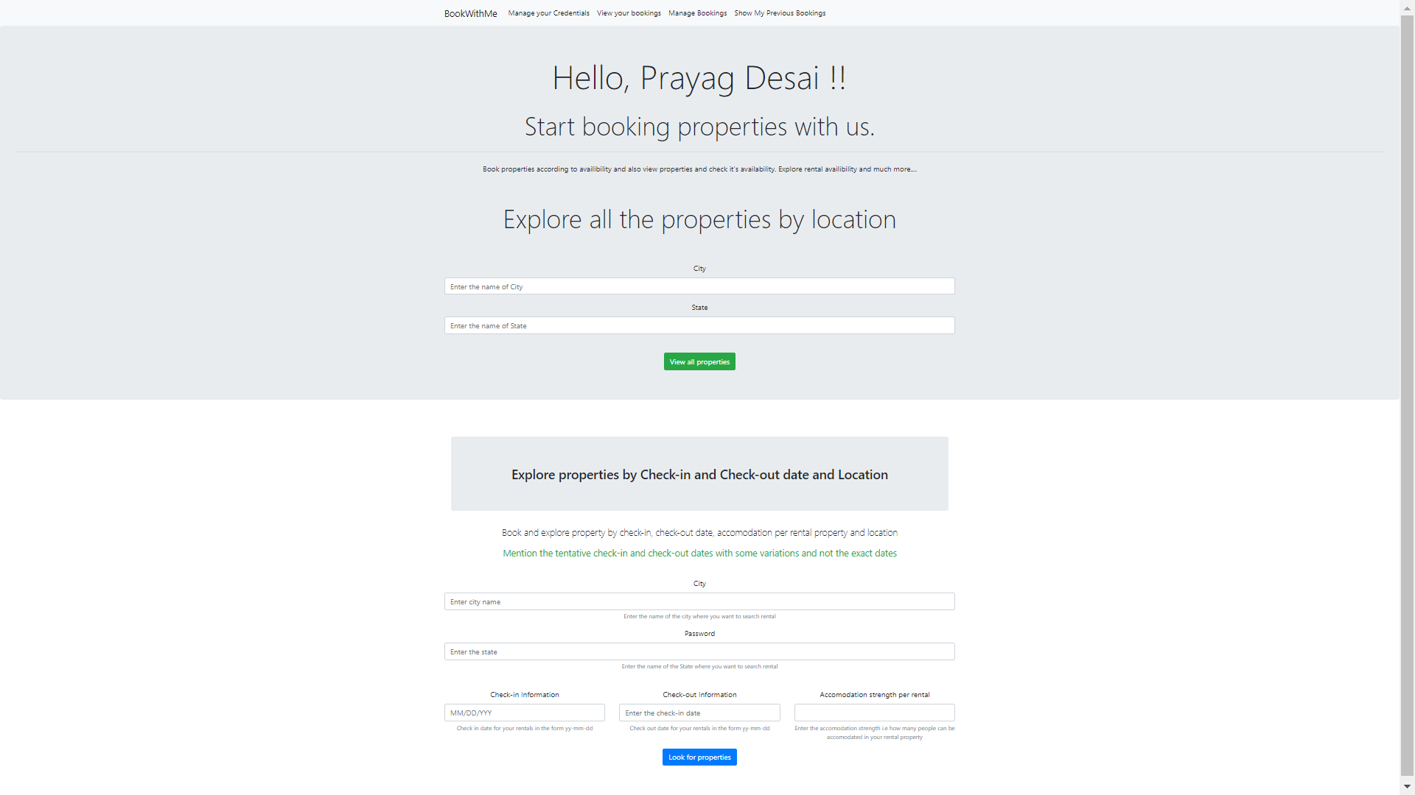
Explore and Book Properties

Slide 16
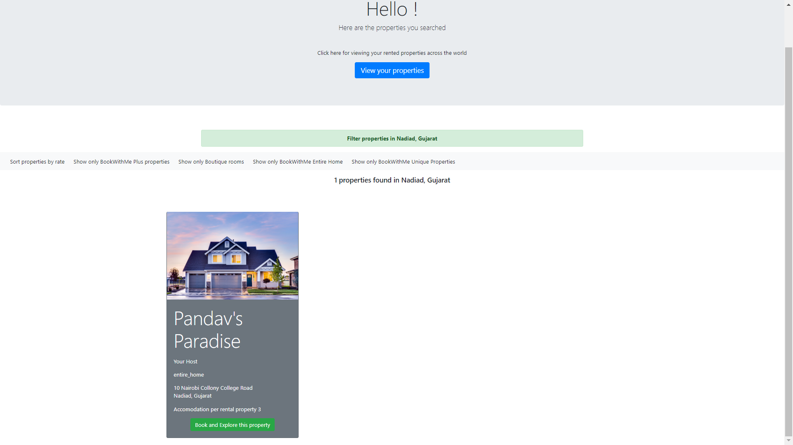
Properties available

Slide 17
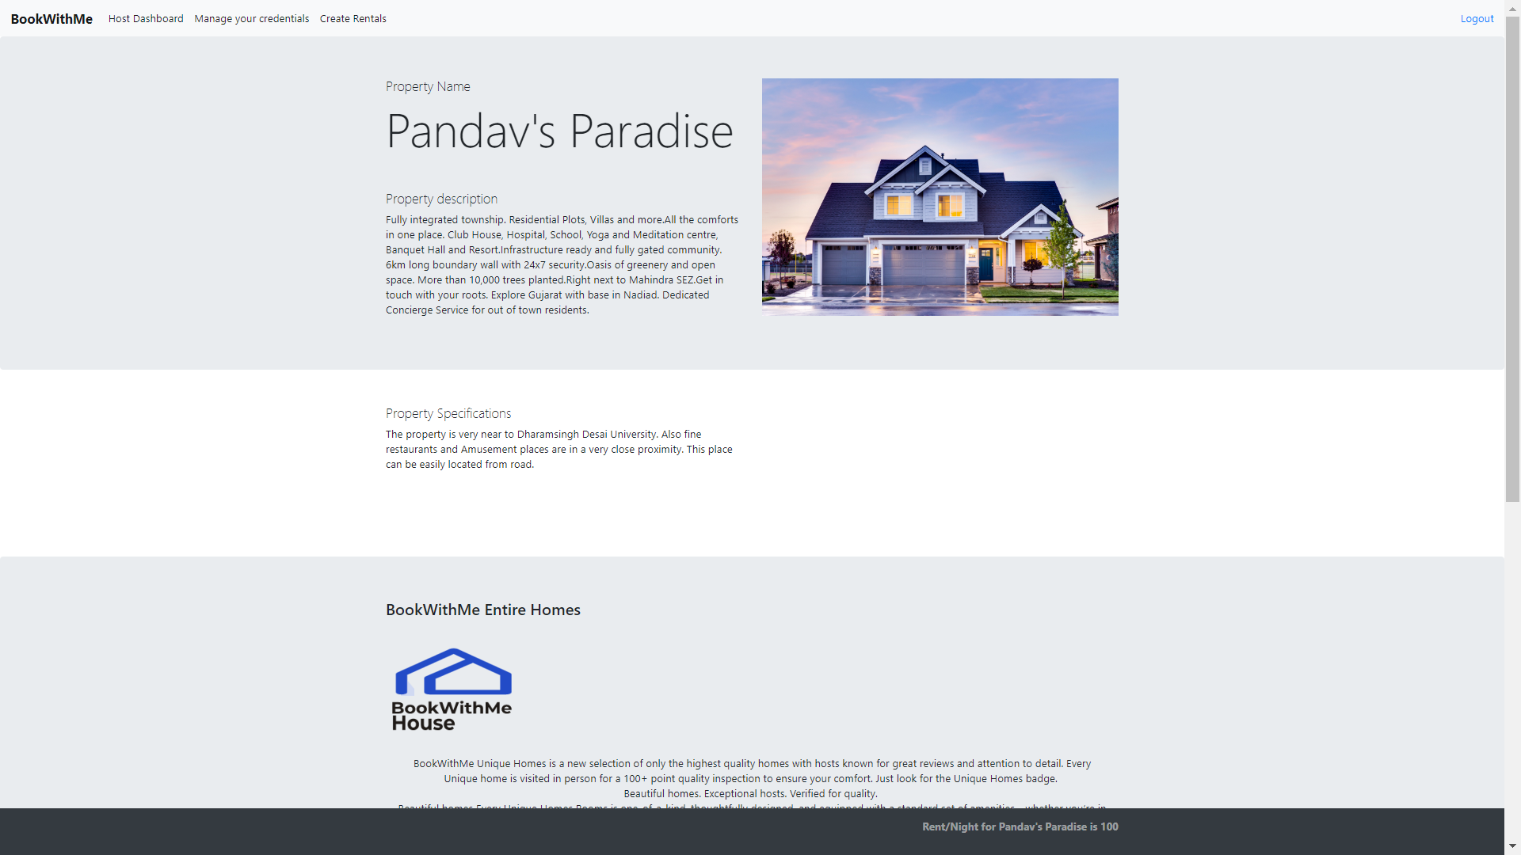
Property Description and book property.

Slide 18
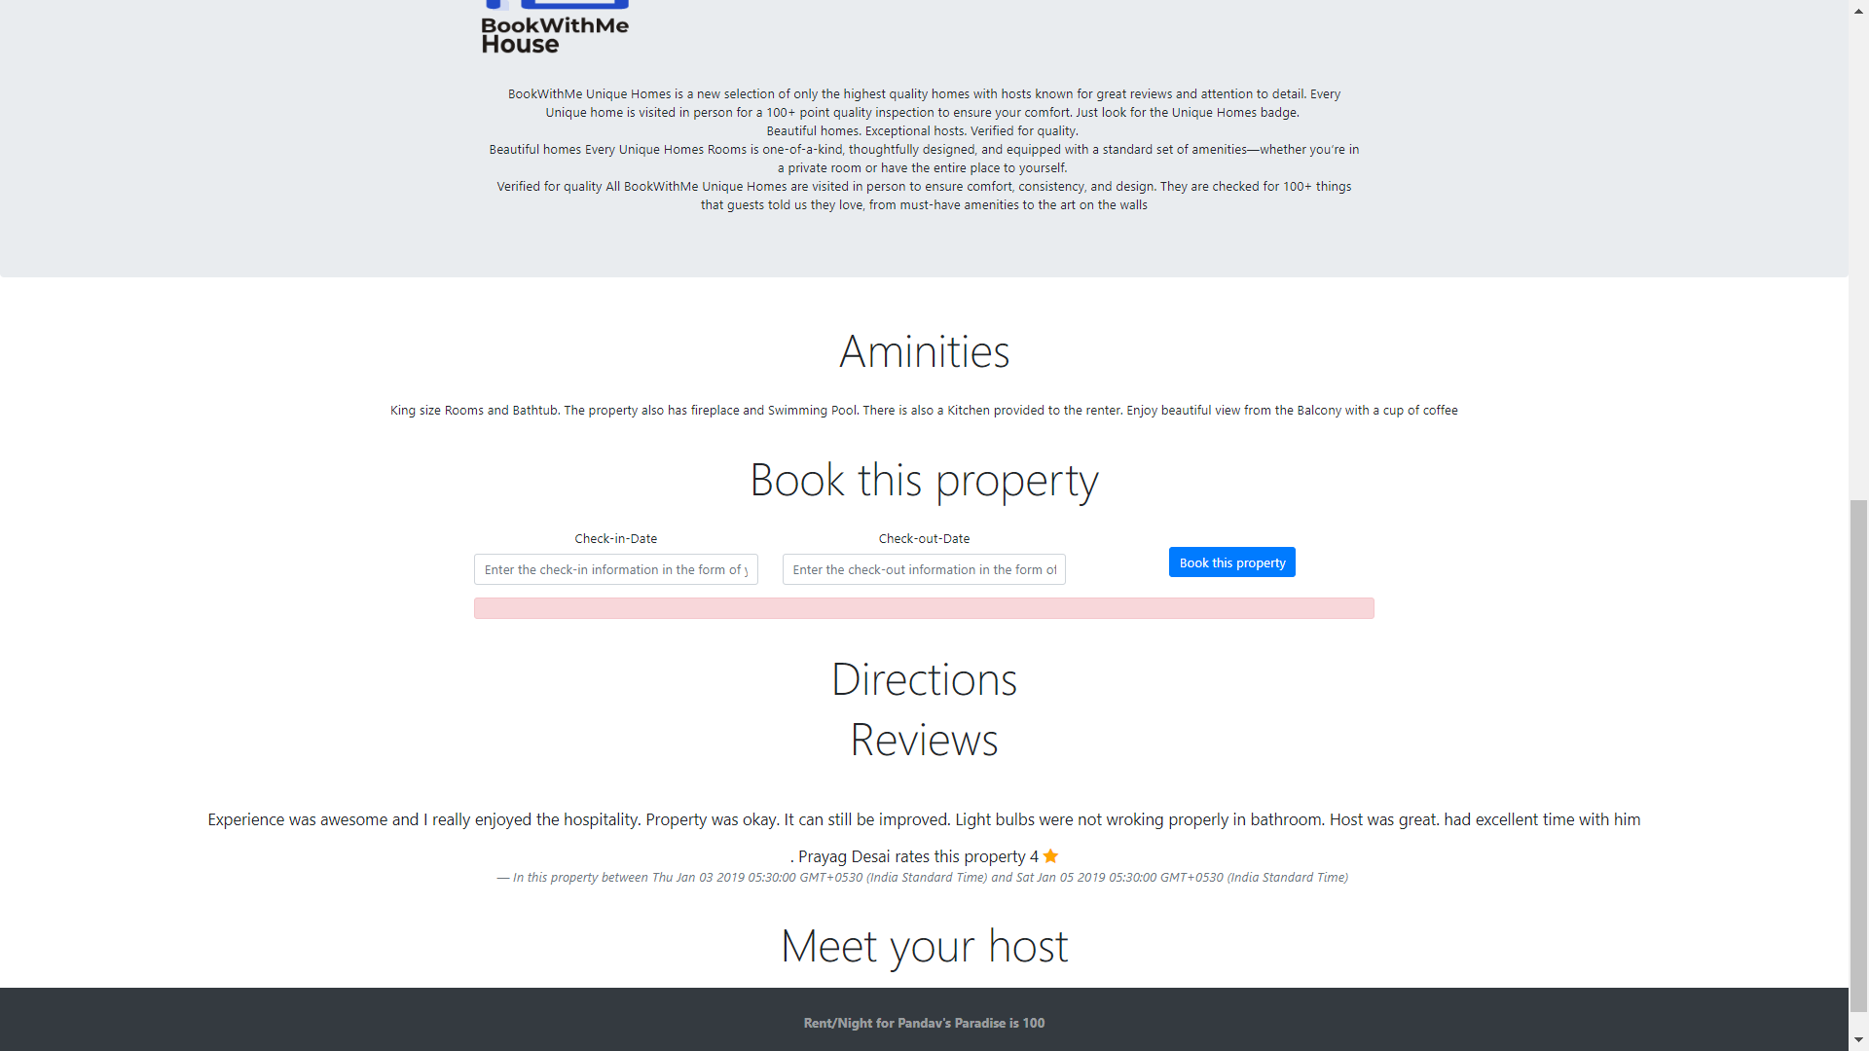
Property Description..

Slide 19
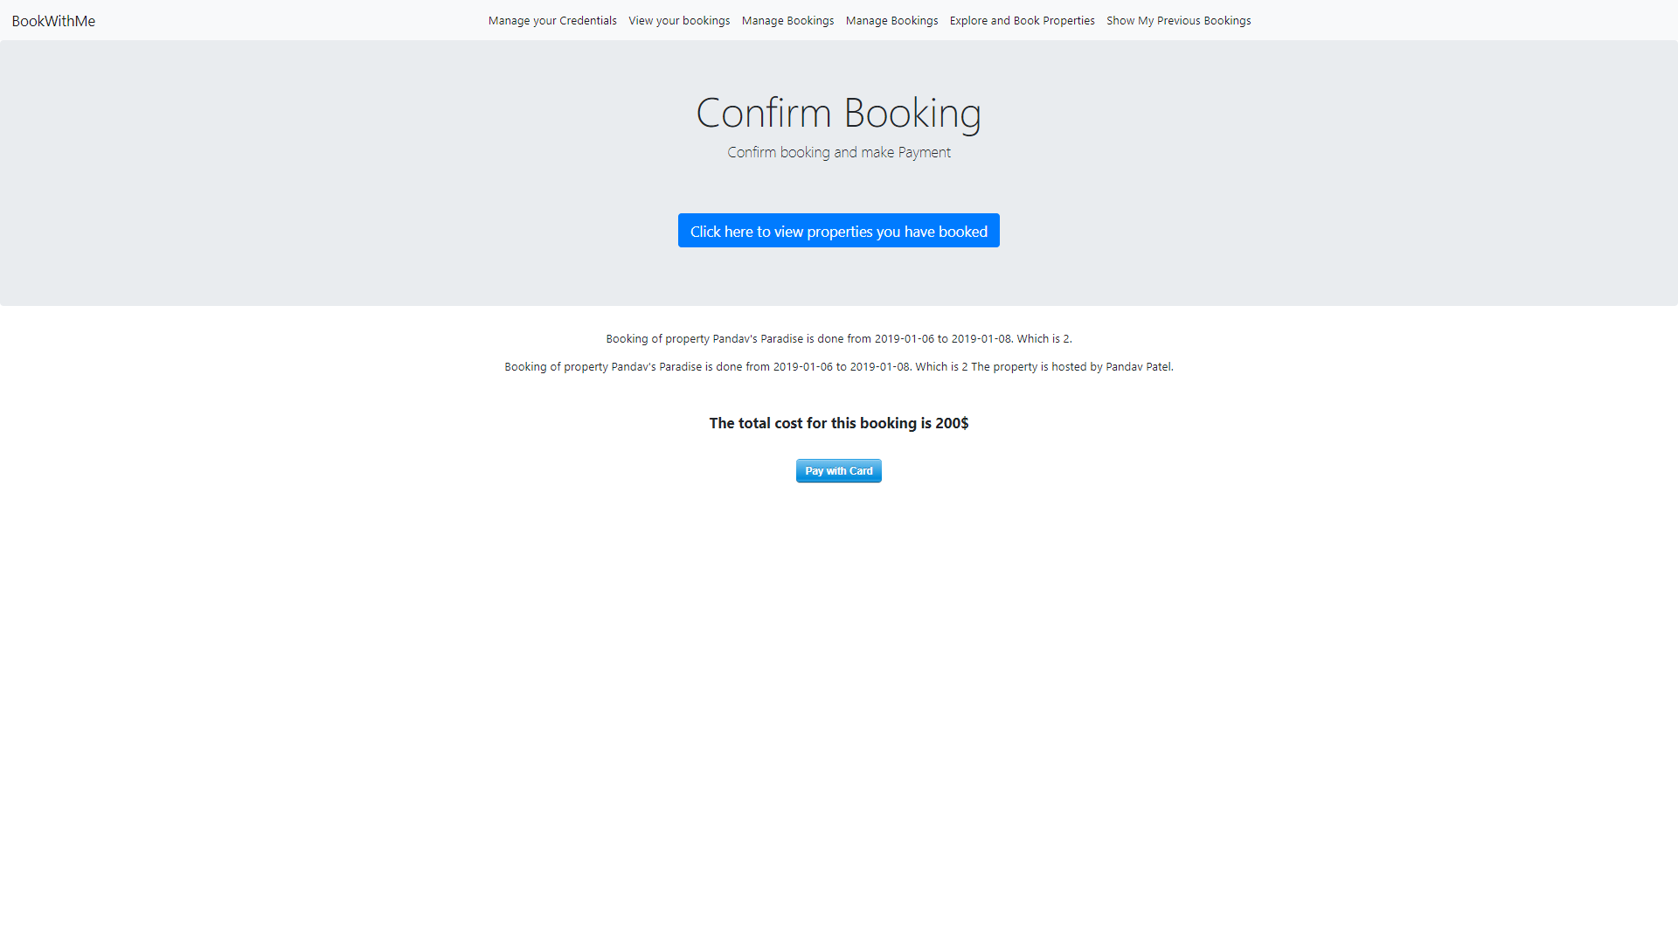
Confirm and pay for booking

Slide 20
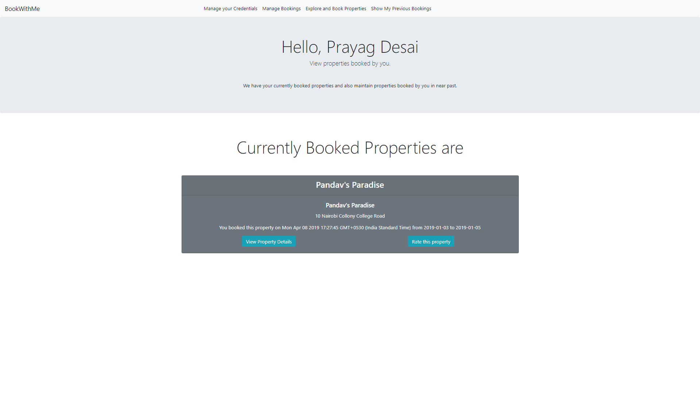
User Dashboard

Slide 21
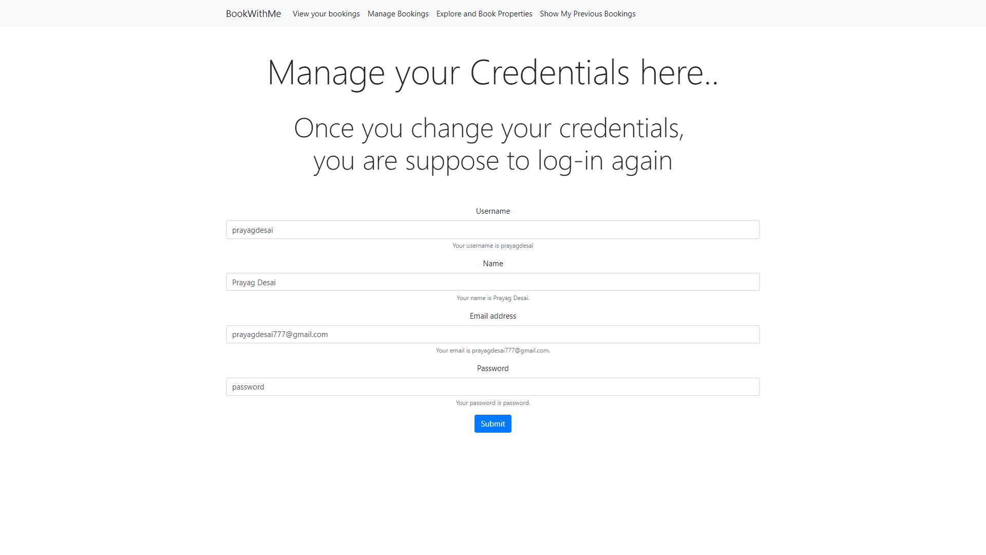
Manage Credentials for Users

Slide 22
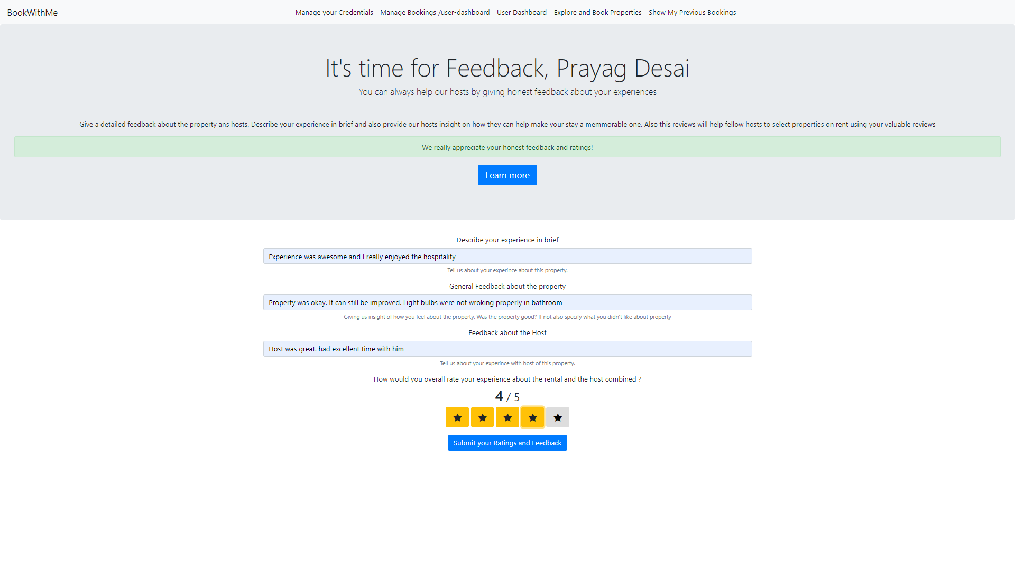
Property Feedback

Slide 23
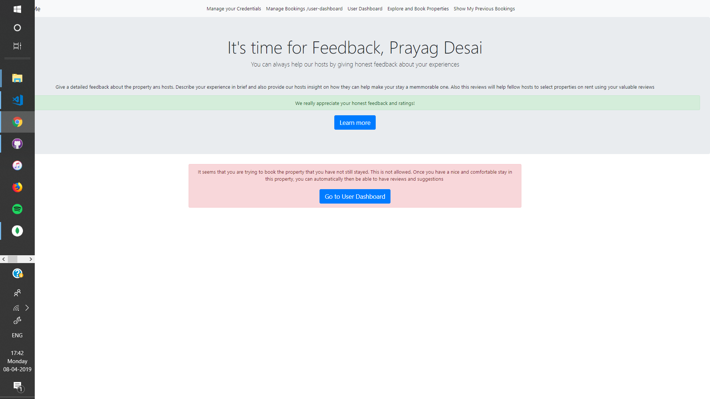
Feedback

Slide 24
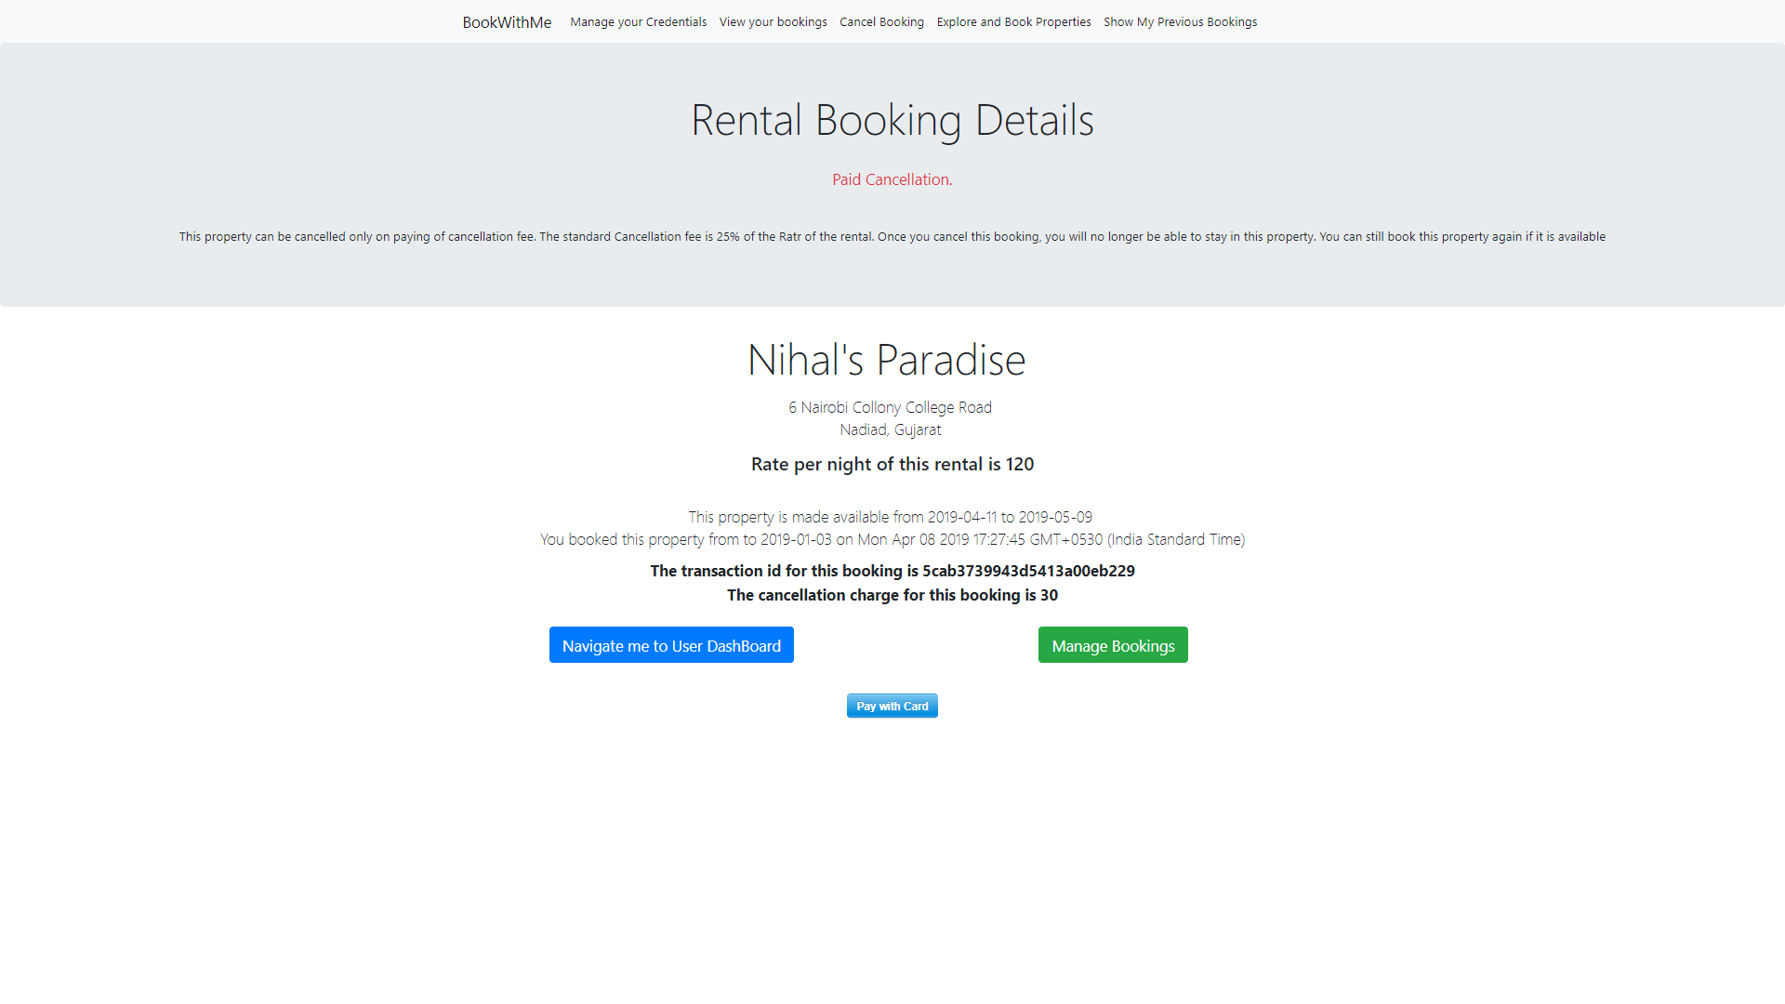
Deleting property which has paid cancellation scheme.

Slide 25
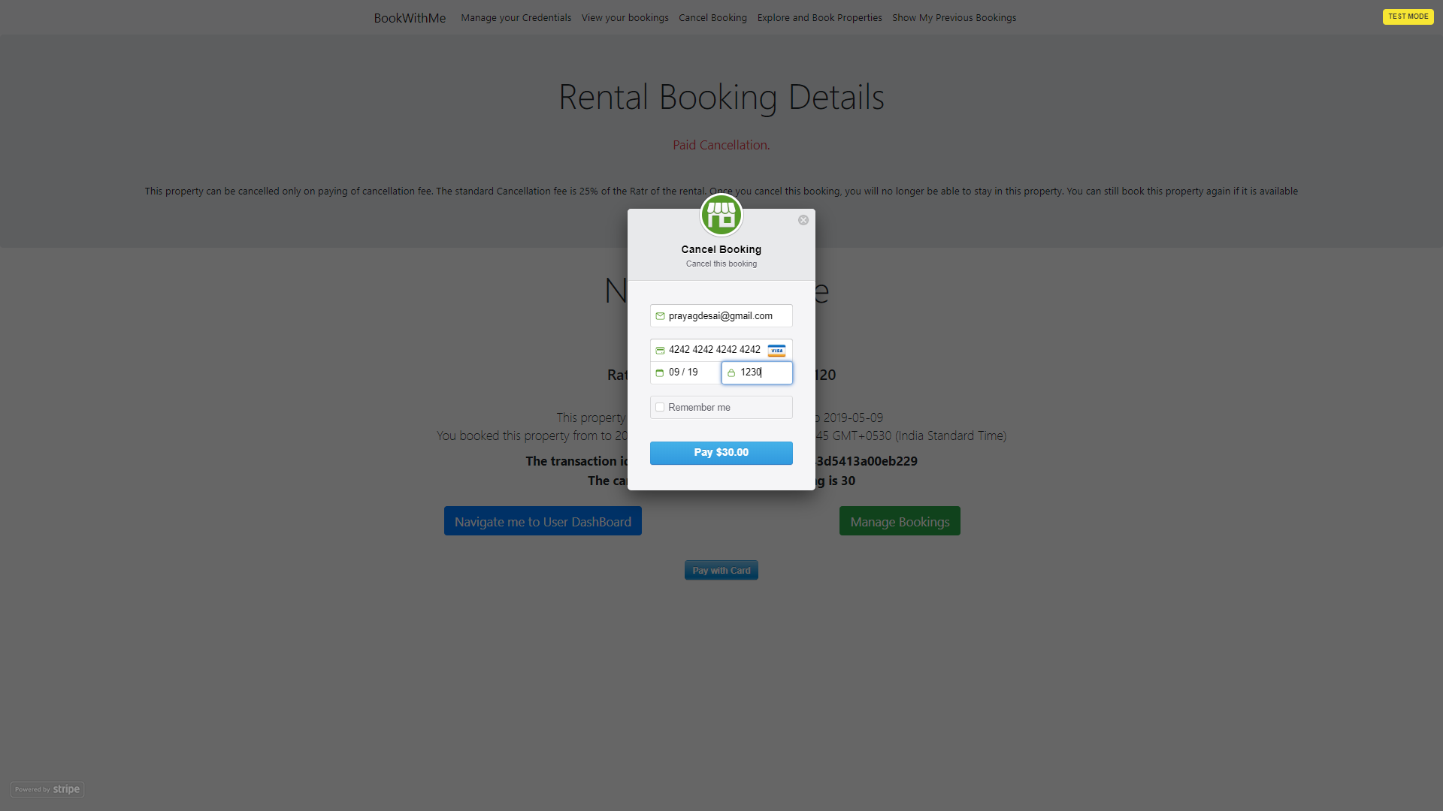

Slide 26
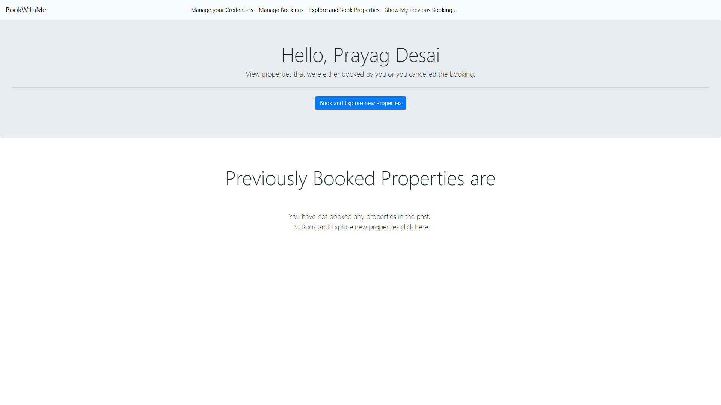
Previously Booked Properties by User

Slide 27
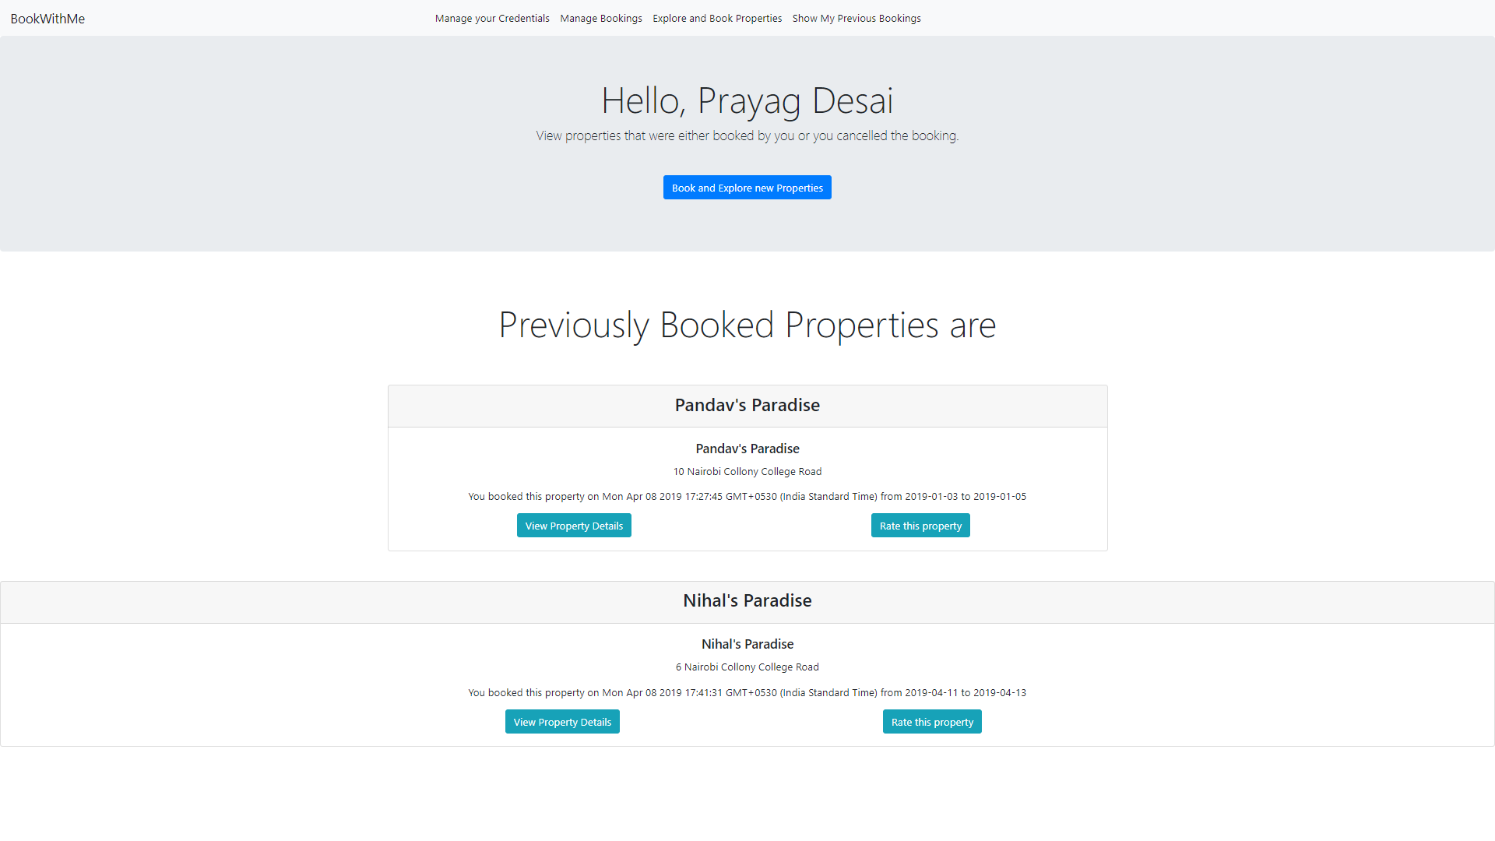
Previously booked properties..

Slide 28
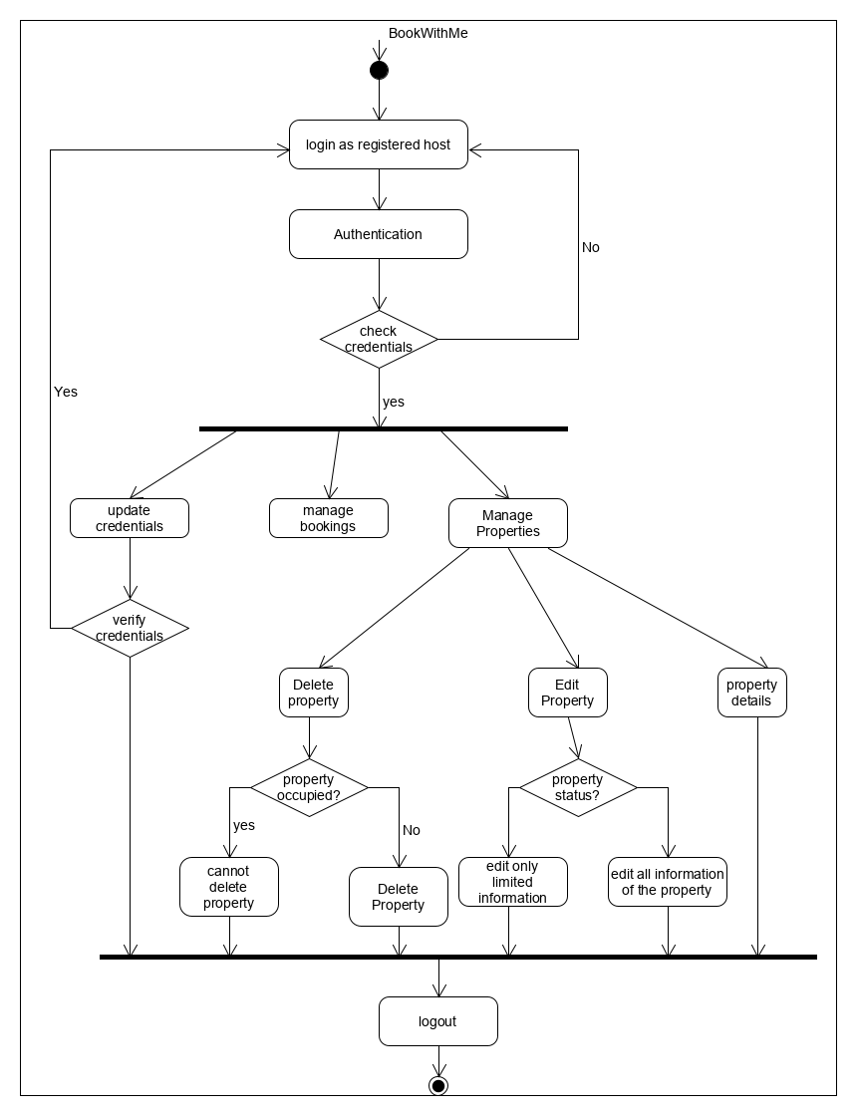
Activity Diagram for Registered Hosts

Slide 29
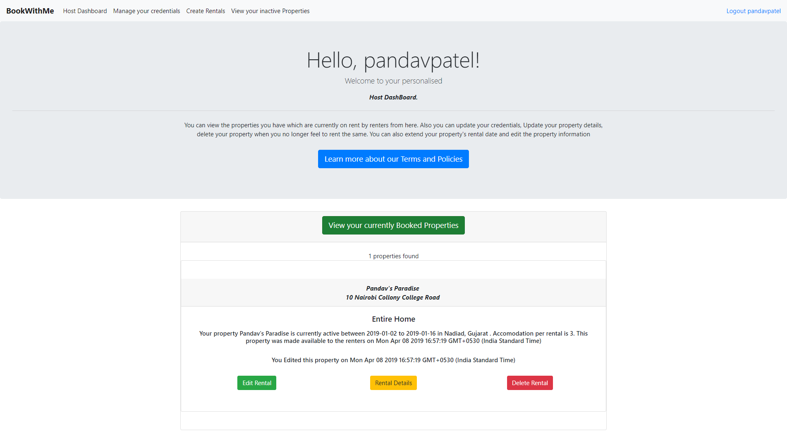
Host Dashboard

Slide 30
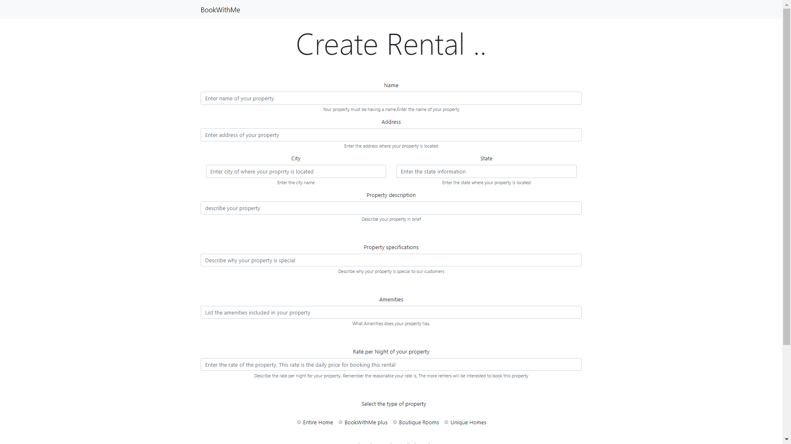
Rent property to Users

Slide 31
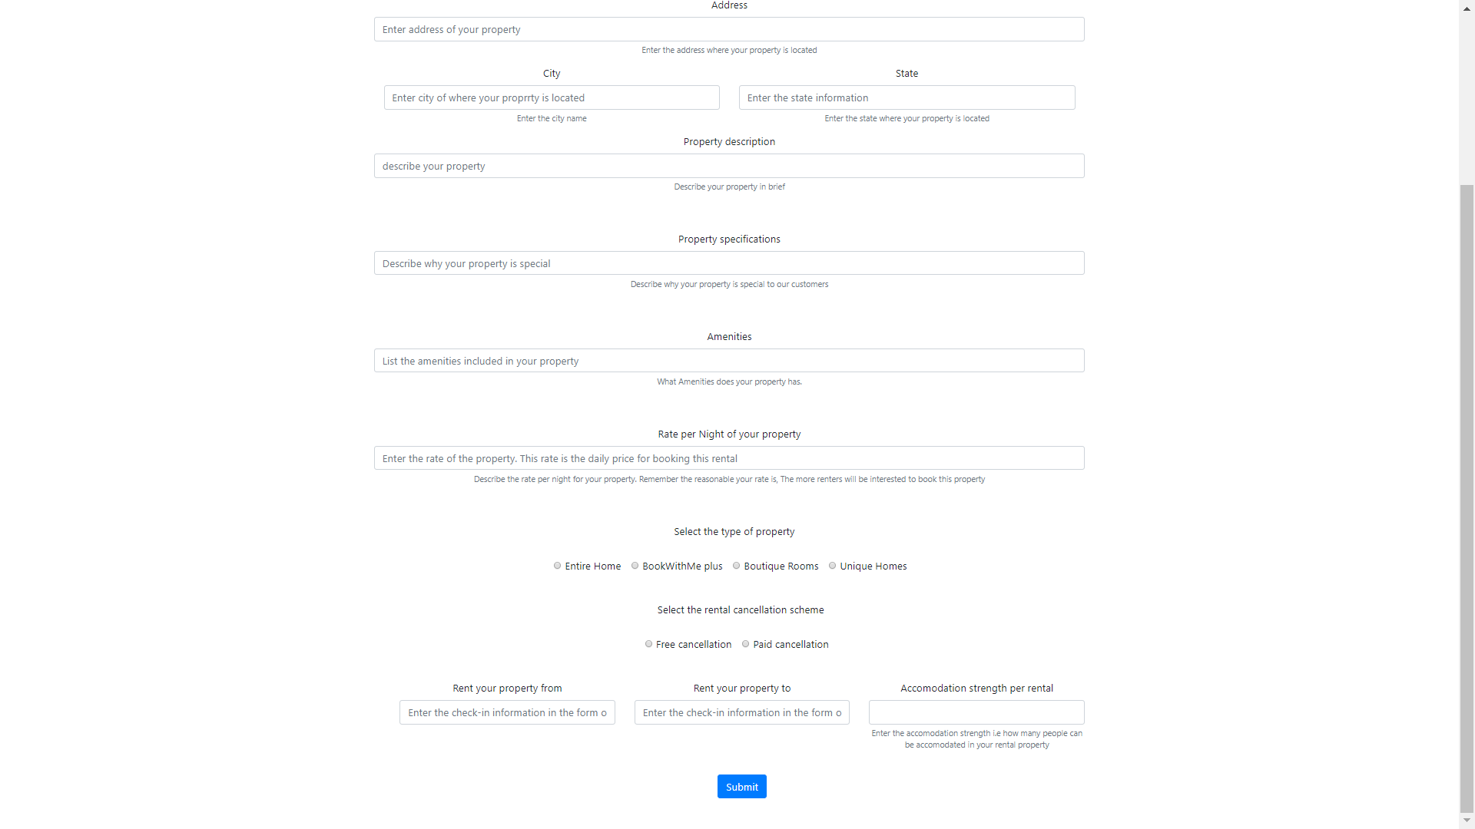

Slide 32
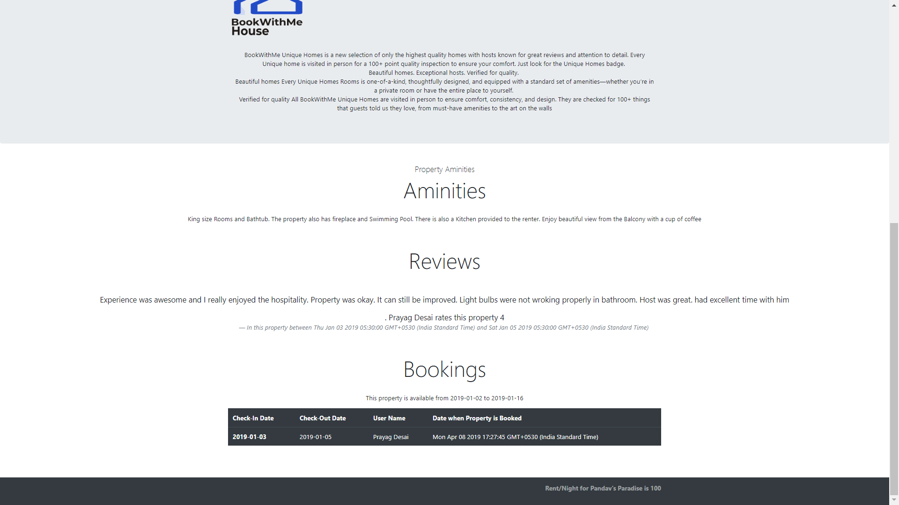
Property description for host

Slide 33
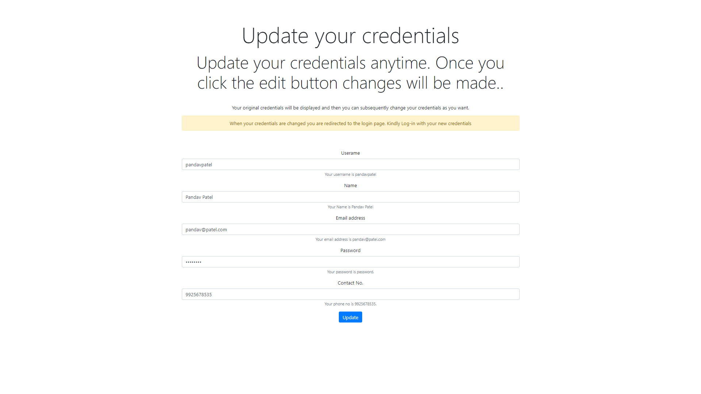
Manage Host credentials

Slide 34
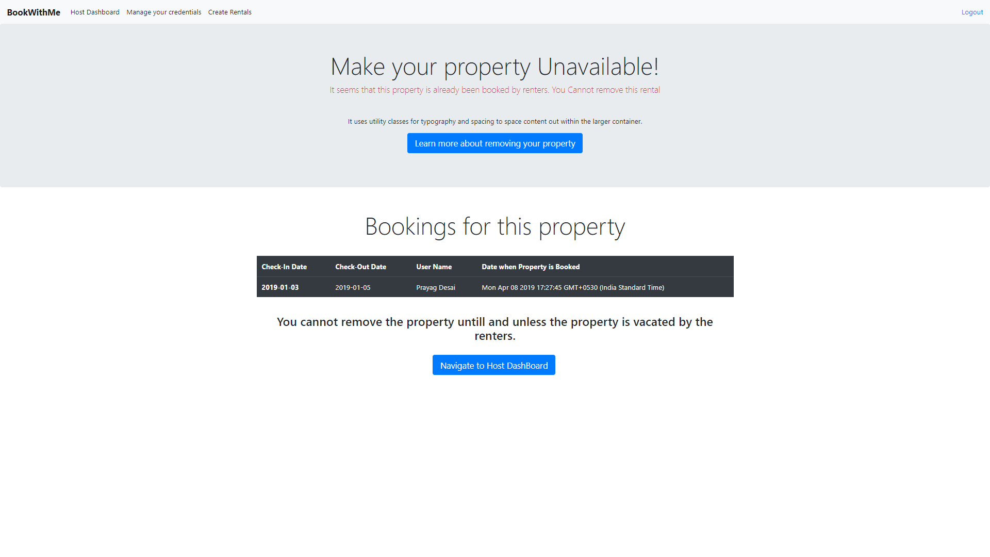
Delete Property which is booked by the Users

Slide 35
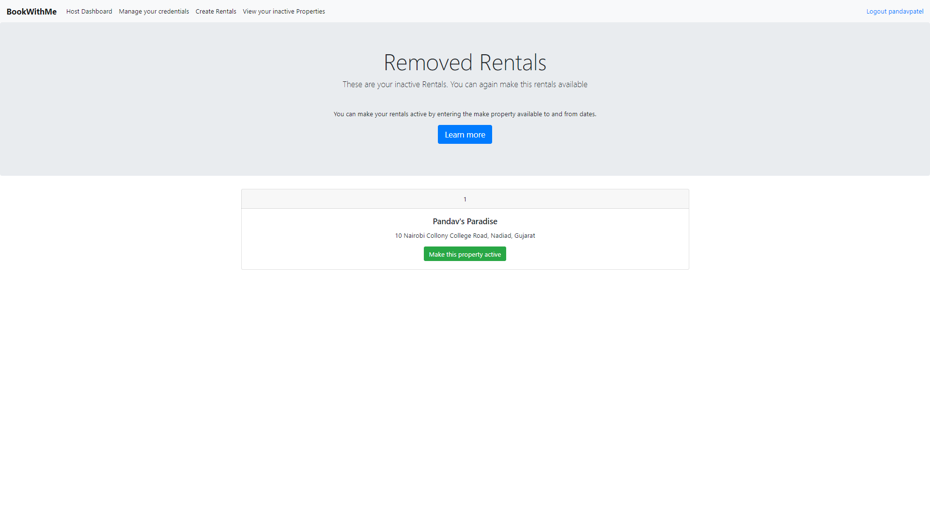
View inactive property

Slide 36
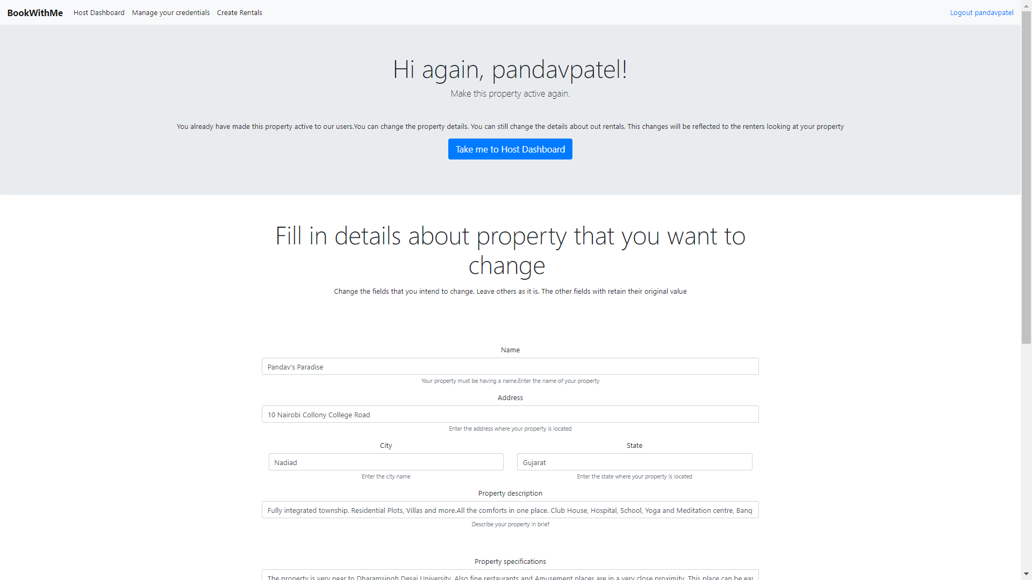
Make Inactive property active

Slide 37
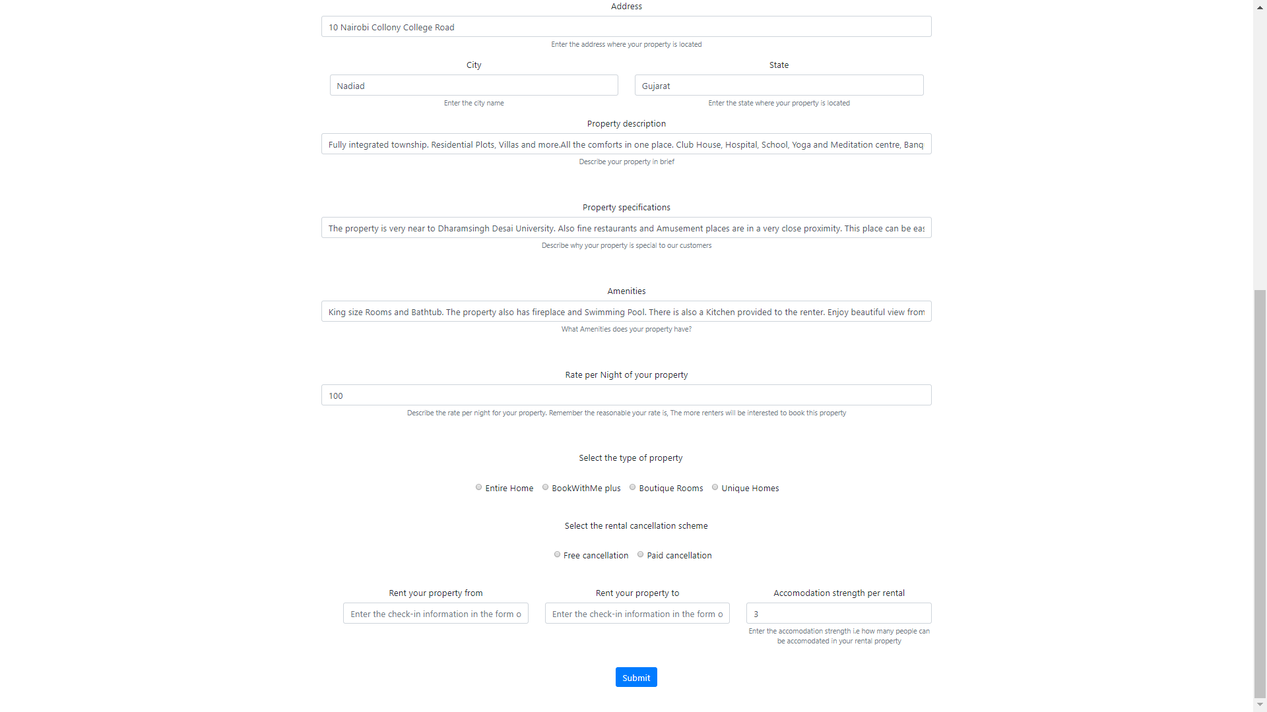

Slide 38
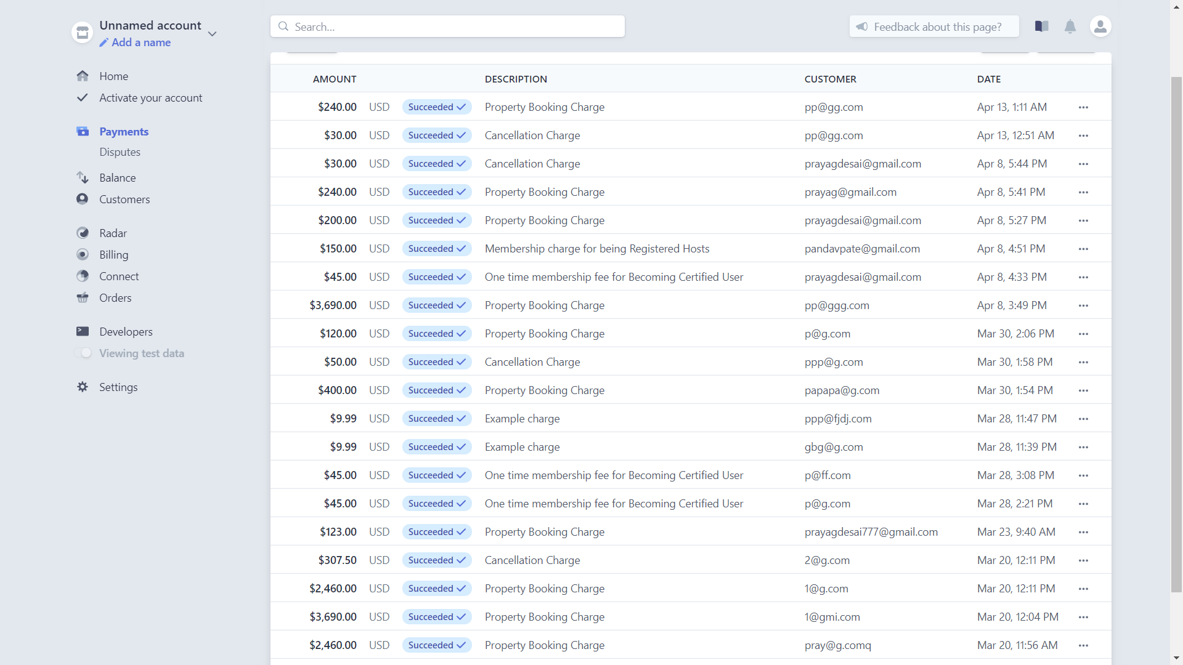
Stripe payment Gateway

Slide 39
Conclusion
This software enables drastically reduce the tedious work on the common functionalities of the online rental booking system.
I have learned new languages and cutting edge technology by implementing this project.
The Users can save money by renting with this platform than to book a hotel and The hosts can generate passive income by hosting their property. Which makes this System a win-win situation for the users and Hosts.

Slide 40
Future Enhancement
Implementing Recommendation System.
Implementation of google analytics.
Image uploading feature by Registered Hosts
Enhancement in the front-end and UX and UI design

Slide 41
Thank you
Prayag Desai(CE-091)

